Slide 1


Slide 2
Agenda
7:00 – 8:30 AM Breakfast/Registration
8:30 – 8:35 AM Welcome/Anti-Trust Admonition
8:35 – 9:30 AM Political Panel: The View… Barry Goldwater, Jr.
Danny Saenz
Jose Montemayor
9:30 – 10:20 AM Looking Back: A “High Tide” Year Gary Pullen
David Walling
G. Michael Sloane
10:20 – 10:45 AM Planes, Trains, Blockchains Tara Mitchell
10:45 – 11:45 AM “To Fee or Not to Fee… Rick Brown
that IS the question!” Jeff Klein
Dennis Burden
11:45 – 12:15 PM Other Business/State Updates John Meetz
12:15 – 1:30 PM Lunch

Slide 3
Antitrust Admonition
  This seminar is intended to inform participants about current developments in the law regarding surplus lines insurance related topics. All persons affiliated with the insurance industry need to be mindful of the constraints of the antitrust laws. There shall be no discussions of agreements or concerted actions that may restrain competition. This prohibition includes the exchange of information concerning individual company rates, coverages, market practices, claims settlement practices, or any other competitive aspect of an individual company’s operation. Participants in this seminar shall not discuss the business interests of any individual insurer or others, including but not limited to, the plans of an insurer involving, or the possibility or desirability of:
    Raising, lowering or stabilizing premiums or commissions;
    Doing business or refusing to do business with particular or classes of insurers, reinsurers, agents, brokers or insureds; or
    Acting in any way that would affect the availability of products or services in any market.

Slide 4





Sponsors

Slide 5



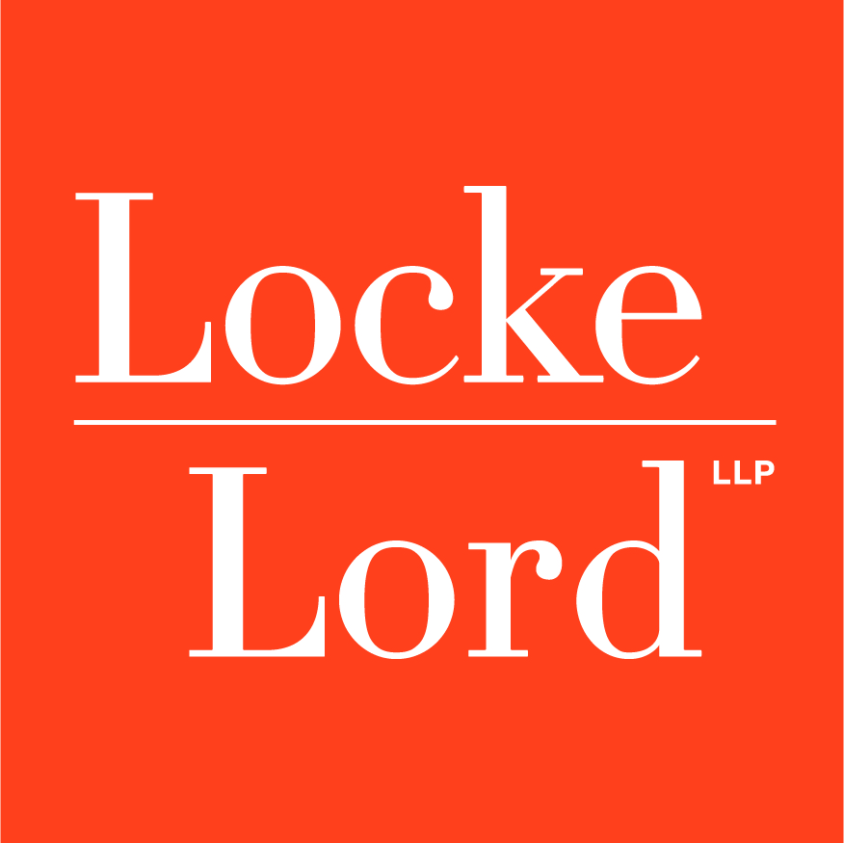
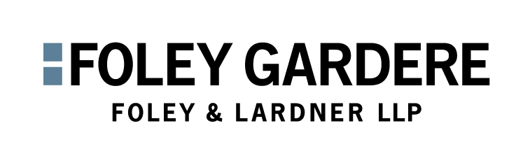


Sponsors

Slide 6
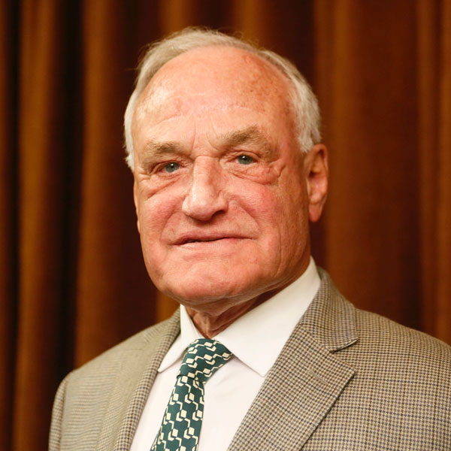
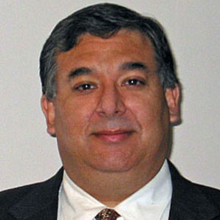
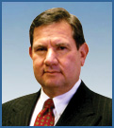
Political Panel
The View…..
Guest Speakers
Former Congressman
Barry Goldwater, Jr.
Chairman Emeritus
NTG Consultants
Danny Saenz
Director & SVP
Business Development
NTG Consultants
Jose Montemayor
Principal
Black Diamond Partners

Slide 7
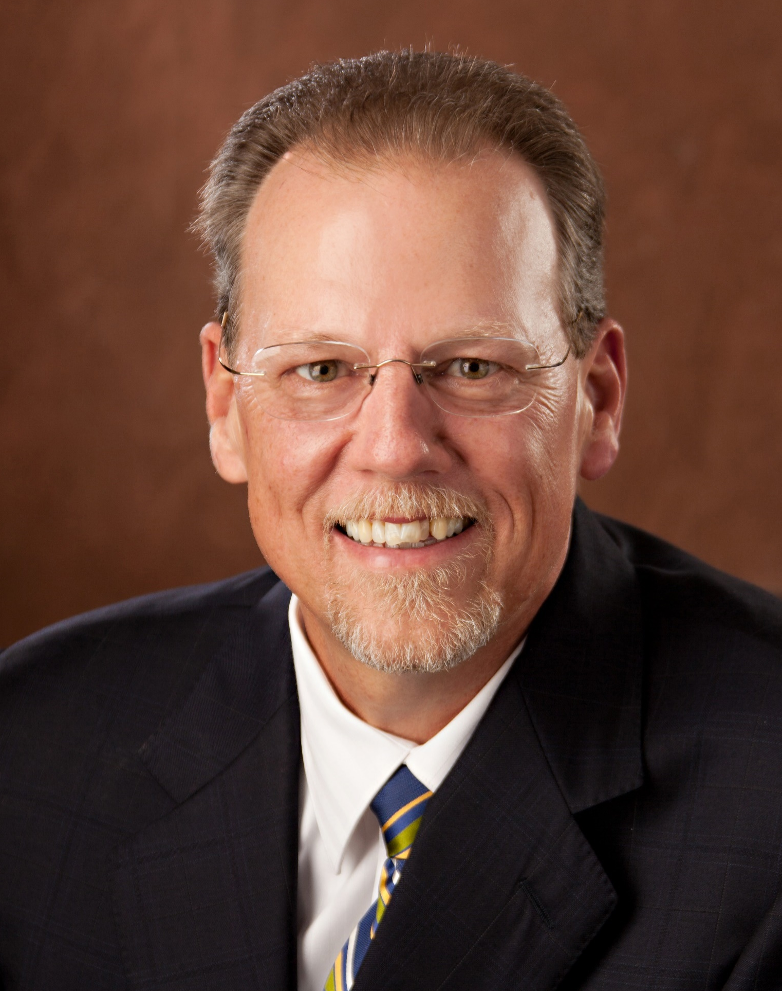
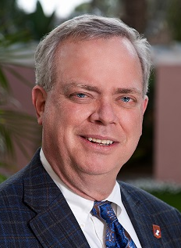

Looking Back:
A “High Tide” Year
Guest Speakers
Gary Pullen
Executive Director
Florida Surplus Lines Service Office
G. Michael Sloane
Executive VP & CMO
Wright National Flood
David Walling
Attorney
Texas Windstorm Ins. Assoc.

Slide 8
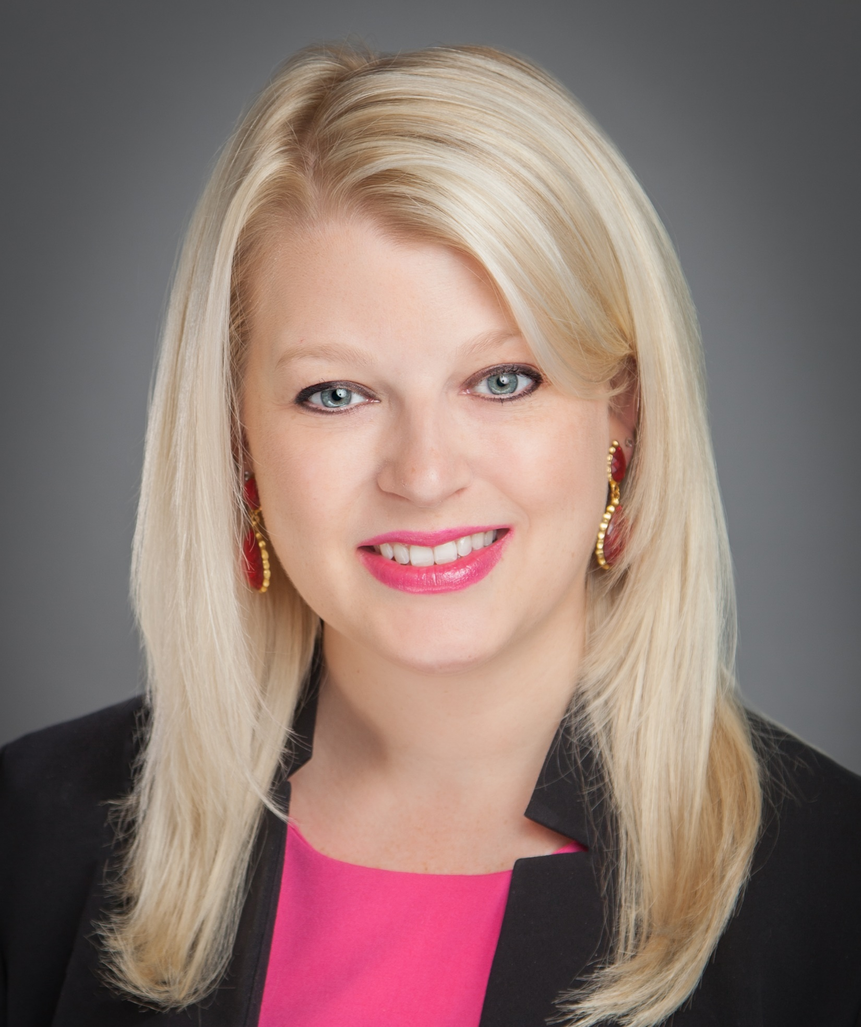
Planes, Trains, and Blockchain
Speaker
Tara Mitchell, AINS, AFE, PMP
SLTX Vice President, ITS/CIO

Slide 9


Understanding Blockchain
Car 1
Car 2
Car 3
Car 4
Coupling
Coupling
Coupling
Original Transactions
Additional Transactions
Additional Transactions
Additional Transactions
Hash
Hash
Hash
Past
Future
Time

Slide 10
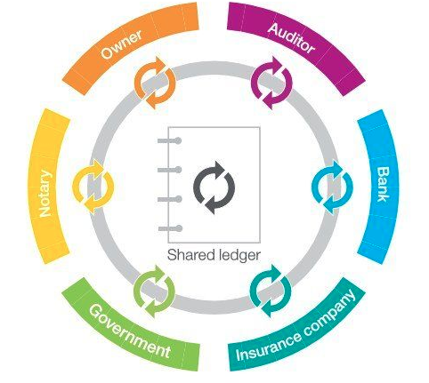
Understanding Blockchain…… Ability to exchange value
Blocks of Information “linked together”
Existing ledger verifiable by all parties
Global & De-centralized trust mechanism
Sharing of Information
3rd Parties, i.e. banking, Paypal…not required for such transactions

Slide 11









Currency Types
Cryptocurrency
Traditional Currency
Bitcoin
Ethereum
$, €, £, ¥
Ripple

Slide 12
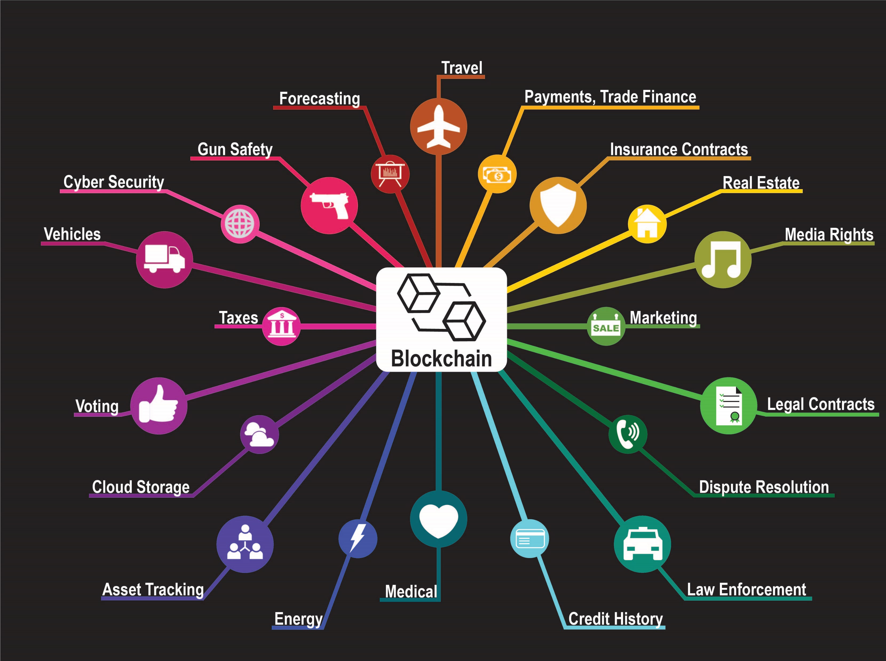
Blockchain
Other Business
Examples
Payments, Trade Finance

Slide 13
Blockchain – Various Insurance Roles
Insured
Smart Contract
P2P
Insurer
Underwriting
Crowdfunding
Claims
Policy Services
Broker/Agent
Retailer
MGA/TPA
Wholesaler
Marketing
Loss Control
Basic Need
Reinsurer(s)
  Multi-Cedent
  Layered Risks
  Risk Modeling
* Risk-related documents can be shared in the ecosystem

Slide 14

Blockchain Distribution Channels
Product
Management
Sales &
Distribution
Underwriting
Business
Policy
Services
Claims
Management
Marketing
1. Contracts
2. Customer Info
3. Policy Info
1. Medical Records
2. Driving Records
3. Pharmacy Records
4. Property Details
1. Policy Renewal
2. Renewal Premium
3. Endorsements
1. Claims Payments
2. Fraud Management
3. Claims process automation

Slide 15
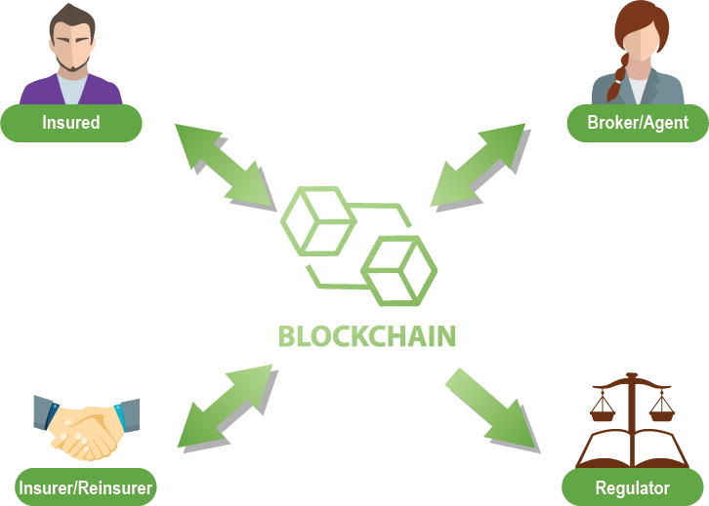
Notes:
Improve multi-party contracts
Claims Management
Reduce disputes
Reduce costs, errors and time
Instant access and legal certainty
Proof of insurance
Multinational policies
Inter-firm accounting
Excess of Loss Reinsurance
Know your customer, anti-money laundering

Slide 16

Challenges
Regulatory
Legal
Data Privacy
Security
Governance
Reliability & Scalability
Integration
Stakeholder Buy-In

Slide 17

On the Horizon…
SafeShare
(Short Term Insurance)
John Hancock
(Life Insurance)
Etherisc
(Flight-Delay)
Slice
(On-Demand)
Lemonade
(Peer 2 Peer)
Microsoft
(Blockchain as a Service)
Notes:
Etherisc wins award for blockchain startup in 2017
SafeShare was named “Insurance Start-up of the Year” 2016

Slide 18
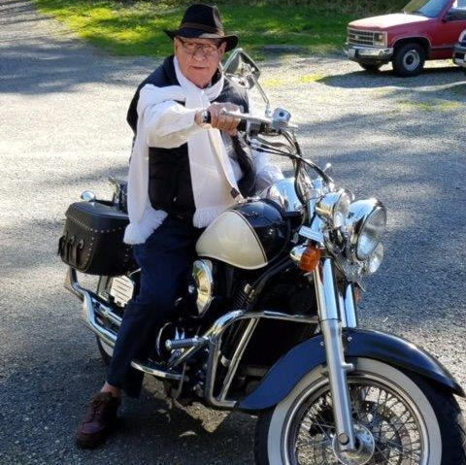
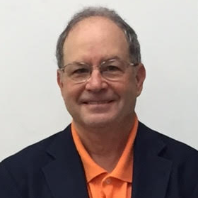

“To Fee or
Not to Fee… that IS the question!”
Guest Speakers
Rick Brown
Attorney
Law Offices of Richard Brown
Jeff Klein
Attorney
McIntyre & Lemon
Dennis Burden
VP, Director, Surplus Lines Tax
Lockton Companies, LLC

Slide 19
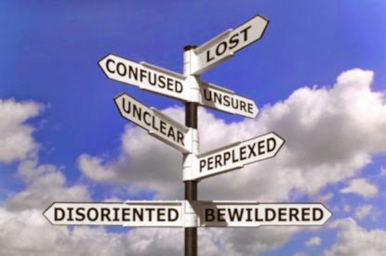
SESSION OBJECTIVES
    Lack of uniformity or ambiguity of state laws & regulations
    Understanding permissible fees/broker fees
    “Reasonable” fees, by retailer and wholesaler
    How they are treated, i.e. taxed in each state
    Implications and/or Distribution System
          Retailer / S/L Wholesaler / Insurer

Slide 20

RETAILERS’ PERSPECTIVES…….
    Customer (insured) facing
    Retailer license evidence, as required by wholesaler
    Forms submitted electronically/online, fax, as required by wholesaler
  Retailer provides disclosure of any excess and surplus lines “statutorily required notices” to insurance buyer, including statutorily-required SL notices

Slide 21
WHOLESALERS’ PERSPECTIVES……
    Collect stamping fee/assessments, and in some states, SL tax, as well as remit to “Home State”
    Record/file/audit policies
    Some Wholesale broker fees are taxed
    Wholesale brokers may charge “reasonable” fees without limitation, except for FL ($35 cap)
    Wholesalers’ agreements with Retailers & Insurers or such “markets”, whom they access
    May be affected by Retailers’ client fees and commissions
    Require Retailers to provide license evidence/verification

Slide 22
INSURERS’ PERSPECTIVES……
  No rules limiting what a surplus lines insurer may charge, including Florida
  Should not duplicate fees that other parties have already charged
  Ability to audit records, negotiate new terms based on changes with P&L, financial capacity, M&A, reinsurance treaties
  (Suggestion) Wholesalers should review their agreements with insurers

Slide 23

OTHER MATTERS
  Sophisticated Insureds
      Full Disclosure - directly/indirectly
  Necessity of Reasonable Fees
      However/whomever imposed
  Myriad of Fees
  Company Fees vs Broker (producer) Fees
      Varying tax treatment
      Insurer-imposed fees are sometimes part of the premium, (in some states)
  Underwriting expense fees and disclosures

Slide 24
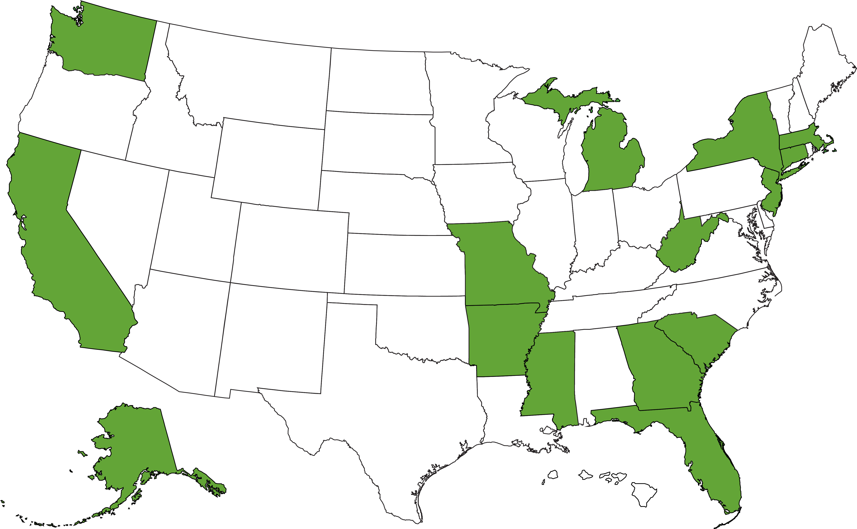
US REGULATIONS
WA: Fees for “underwriting, issuance, processing, inspecting, servicing, & auditing policies” with “reasonable, documented, & verifiable” costs
NY: Inspection fee permissibility. The entity ordering for the fee determines if it is subject to premium tax.
MA: Inspection fees must be required by the insurer and disclosed.
MI: 0.5% regulator fee
MO: Includes policy fees, fees charged by the producer acting as a MGA, & any other fees not to be included as premium.
Fees imposed under PSA, fees paid by insurer to producer are NOT subject to premium tax
CT: Cap of $250 for producer/broker fee or up to 5% of premium not to exceed $500 aggregate
CA: Insurer fee authorization required & taxed as premium.
Broker fees are not taxable as premium.
WV: Similar to Washington
NJ: S/L producer may not charge a fee to an “originating broker” for procurement of a S/L policy: limited to $50 for personal lines or 2% of premium for Commercial lines, for policy period, but not to exceed $100, but in no event to exceed $250
AR: Premium includes assessments, membership fees, policy fees, servicing, inspection, and similar fees
SC: Policy fees must be reasonable
AK: “A policy fee in statute may not be the same thing that is often referred to as a policy fee in various industry nomenclature”
GA: Fees have to be authorized by insurer, prominently disclosed, included as premium, and be subject to tax
MS: Wind pool assessments, similar to Citizens, FL cat fund
FL: $35 policy fee. Service fee of 0.1% premium to offset FSLSO transactional expenses

Slide 25
US REGULATIONS
State | Statute/Regulation
Alaska | Distinction between premium, policy fees and broker fees: “a policy fee in statute may not be the same thing that is often referred to as a policy fee in various industry nomenclature”
Arkansas | Premium includes assessments, membership fees, policy fees, servicing, inspection and similar fees
California | Insurer has to authorize the Surplus Lines Broker to retain any fees but if it does, it has to be considered part of the premium base. Fees not taxable as premium: those solely for benefit of broker and not remitted to the insurer.
Connecticut | Cap of $250 fee for producer and SL broker fee, or alternatively, a fee of up to 5% of premium not to exceed $500 in aggregate
Florida | $35 policy fee. To whom does the cap apply? Service fees to offset FLSLO transactional expenses, 0.1% of premium
Georgia | Fees are ok but need to be part of premium. Have to be authorized by carrier, included in premium and subject to SL premium tax and prominently disclosed.
Massachusetts | Inspection fees must be required by insurer and disclosed. Query: what is a reasonable “markup” to offset administrative expenses and policy servicing? Wholesalers and retailers?
Michigan | Has a 0.5% “regulatory fee”
Mississippi | Many wind pool type assessments similar to Florida Cat Fund and Citizens
Missouri | Fees include policy fees, fees charged by producer acting as MGA, and any other fees and not be included as premium. If fees imposed pursuant to a producer service agreement, fees paid by insurer to producer are NOT subject to premium tax. Is this conflicting?
New Jersey | Prohibits a Surplus Lines producer from charging a fee to an “originating broker” for negotiation/procurement of a surplus lines policy: limited to $50 for Personal Lines, and for Commercial Lines 2% of premium, for policy period, but not to exceed $100; but in no event to exceed $250
New York | Inspection fee permissibility. Depends on who is ordering it and then that determines whether it is subject to premium tax
Rhode Island | Broker fees must be reasonable to cover underwriting expenses of agent/broker and must be fully disclosed directly or indirectly (via another licensed producer) to the insured
South Carolina | Policy fees must be “reasonable”. What constitutes “reasonable”? Is there a given “market rate”?
Washington | Licensee may charge fees for “underwriting, issuance, processing, inspecting, servicing and auditing policies”. But service must be required by the SL insurer and must have been actually provided by producer. Also, cost must be “reasonable, documented and verifiable”.
West Virginia | Similar to Washington

Slide 26
SESSION FINAL THOUGHTS
  Disclosure is everything
  Suggested Best Practice - Broker Fee Agreement (BFA) between Retailer & Wholesaler
              Broker compensation;
              Policy servicing; and
              Risk management, loss control etc.
  Opportunities with BFA fee agreement
            Match provision of insurance products and services with client expectations
            “One-stop shopping”, and in some cases
            One source/form of compensation
  Follow such terms and practices to avoid disputes and regulatory issues
  Comprehension of statutes and regulatory compliance
  Macro level tool exploration/development of a centralized navigation system
  Develop a think-tank and perhaps, a continuation at next SLLG session
  Questions, Comments, and/or Observations

Slide 28
Surplus Lines Law Group
April 27, 2018 – Austin, texas

